Slide 1

Project 1
GAMING INDUSTRY ANALYSIS

Slide 2

What is a video game?
A video game can be defined as an interactive electronic medium that generates visual images through a computer program on a display screen.
Why do people play games?
For many individuals, playing video games serves multiple purposes, such as providing an avenue for relaxation, allowing them to exert control, promoting enjoyment and creativity, enabling socialization, preventing boredom, providing challenges, and offering a sense of accomplishment. Additionally, video games may serve as coping mechanisms for managing stress and other challenging life circumstances.
Why this analysis?
Playing Video games has several benefits, including stress and pain relief, socialization, and development of problem solving skills.
The video game industry is expected to exceed $350 billion with an annual growth rate of more than 7% in 2023

Slide 3



GAMING INDUSTRY ANALYSIS
Section 1
Section 2
Section 3
Overview of Gaming Industry
Streaming on Twitch
Esports

Slide 4

SECTION 1
OVERVIEW OF GAMING INDUSTRY
6

Slide 5

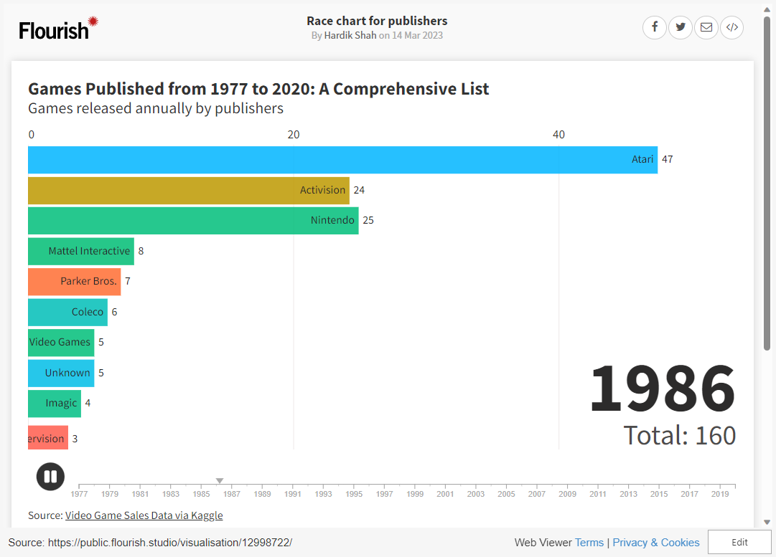
Visualizing the Growth and Dominance of Publishers
The race chart shows growth in the gaming industry from 1977-2020, with Activision publishing the most games at 1024, followed by Ubisoft at 950 and Electronic Arts at 829.
1
This is the first
thing.
4
This is the fourth
thing.
2
5
This is the fifth
thing.
3
6

Slide 6
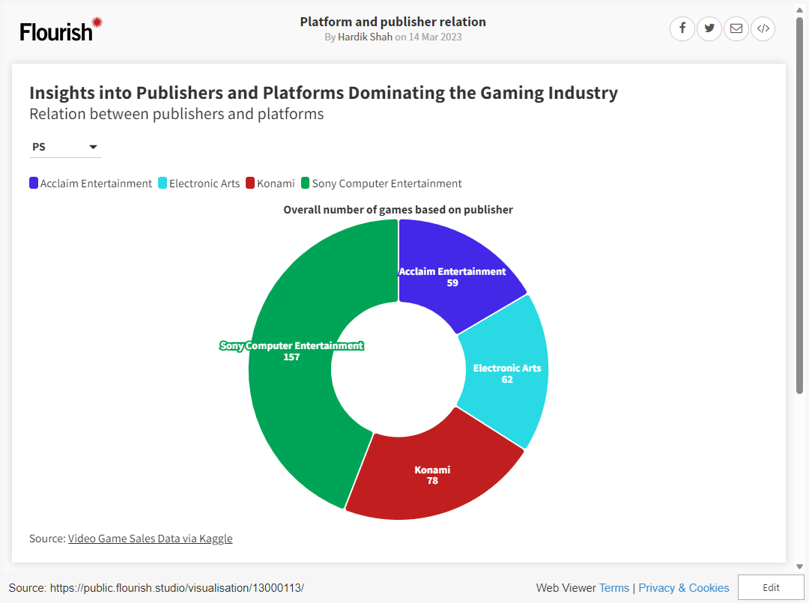
An Overview of Publishers and Platforms
1
This is the first
thing.
4
This is the fourth
thing.
The gaming industry's dynamics, reveals the dominant publishers and platforms, including Electronic Arts and PlayStation 2, while Nintendo releases fewer games on multiple platforms.
2
This is the second
thing.
5
This is the fifth
thing.
3
This is the third
thing.
6
This is the sixth
thing.

Slide 7

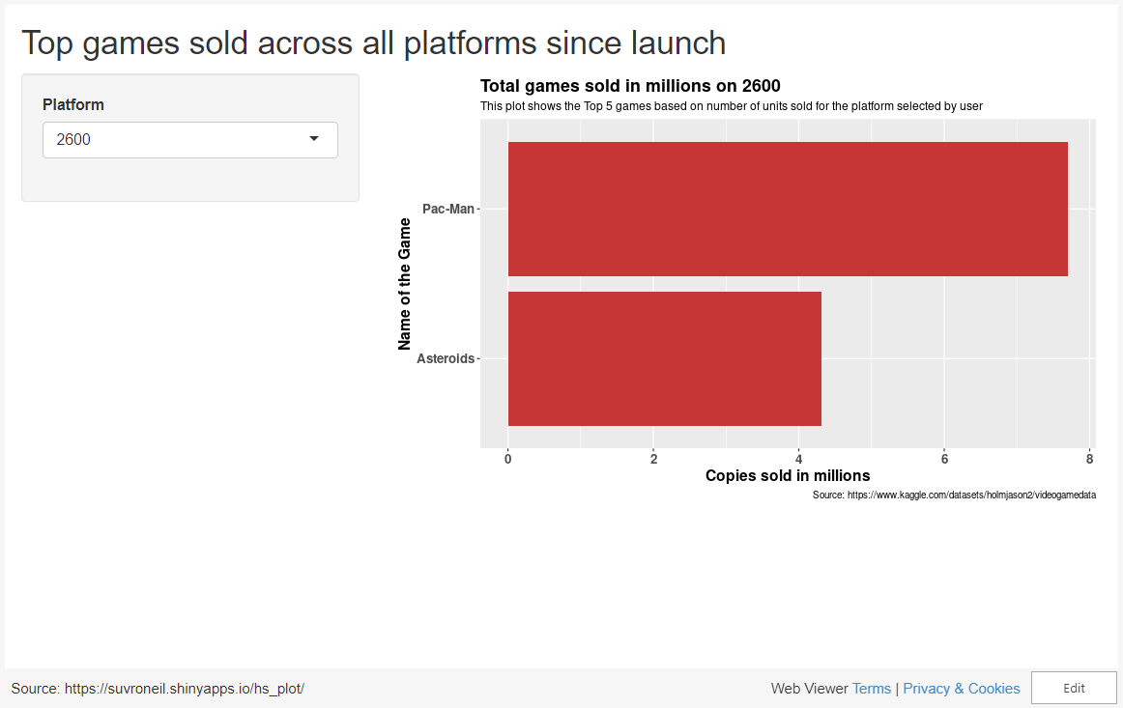
Top Games sold across all platforms
The bar graph ranks best-selling games by total copies sold in millions, with Wii Sports topping the list at 82.9 million copies, followed by Super Mario Bros. at 40.24 million copies and Counter-Strike: Global Offensive at 40 million copies.
1
This is the first
thing.
4
This is the fourth
thing.
2
This is the second
thing.
5
This is the fifth
thing.
3
This is the third
thing.
6
This is the sixth
thing.

Slide 8

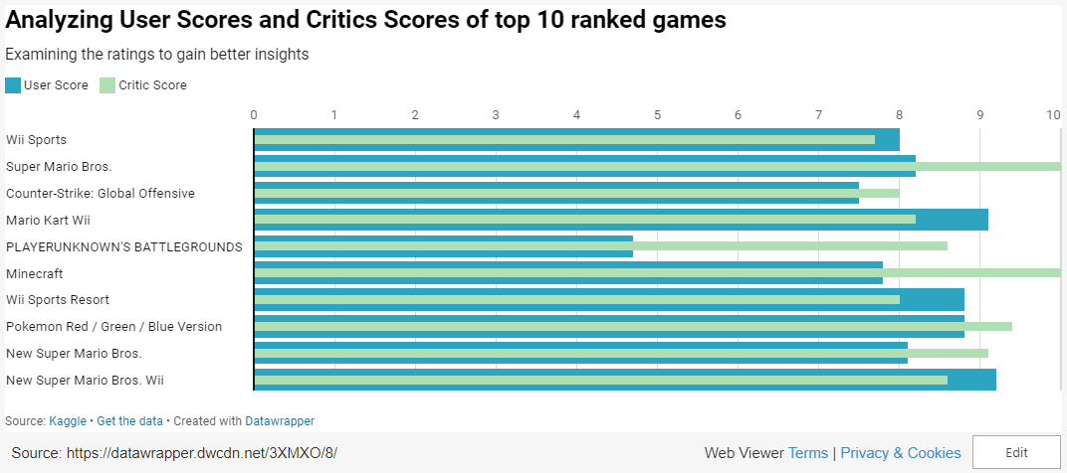
Analyzing User Scores and Critics Scores of Top Video Games
The charts indicate Super Mario Bros. and Minecraft as highest-rated games among critics, Mario Kart Wii and New Super Mario Bros. Wii among users, while PLAYERUNKNOWN'S BATTLEGROUNDS received mixed reviews. Wii Sports, Wii Sports Resort, and New Super Mario Bros. received high scores from both critics and users, and Pokemon Red/Green/Blue Version got the highest critic score of 9.4.
1
This is the first
thing.
4
This is the fourth
thing.
2
This is the second
thing.
5
This is the fifth
thing.
3
This is the third
thing.
6
This is the sixth
thing.

Slide 9

2
TWITCH
STREAMING
7

Slide 10

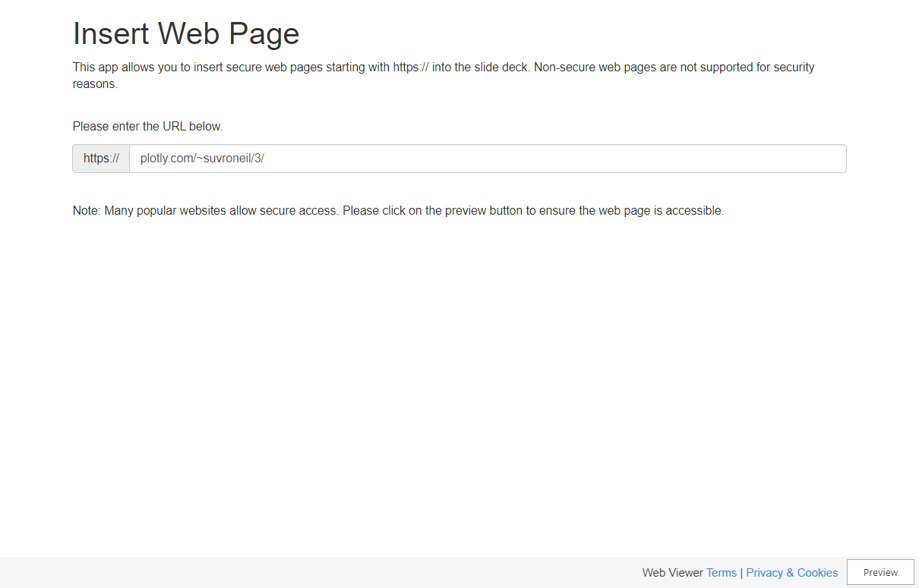
Analyzing the number of Twitch users over the years
The plot shows the gradual increase of Twitch users from 2016 to 2019, a significant increase in 2019-2021 possibly due to COVID-19 lockdowns, followed by a drop in 2022, possibly due to streamers moving to other platforms, Twitch banning gambling content, and revenue split changes, and a decrease in average viewers in January 2023.
1
This is the first
thing.
4
This is the fourth
thing.
2
This is the second
thing.
5
This is the fifth
thing.
3
This is the third
thing.
6
This is the sixth
thing.

Slide 11

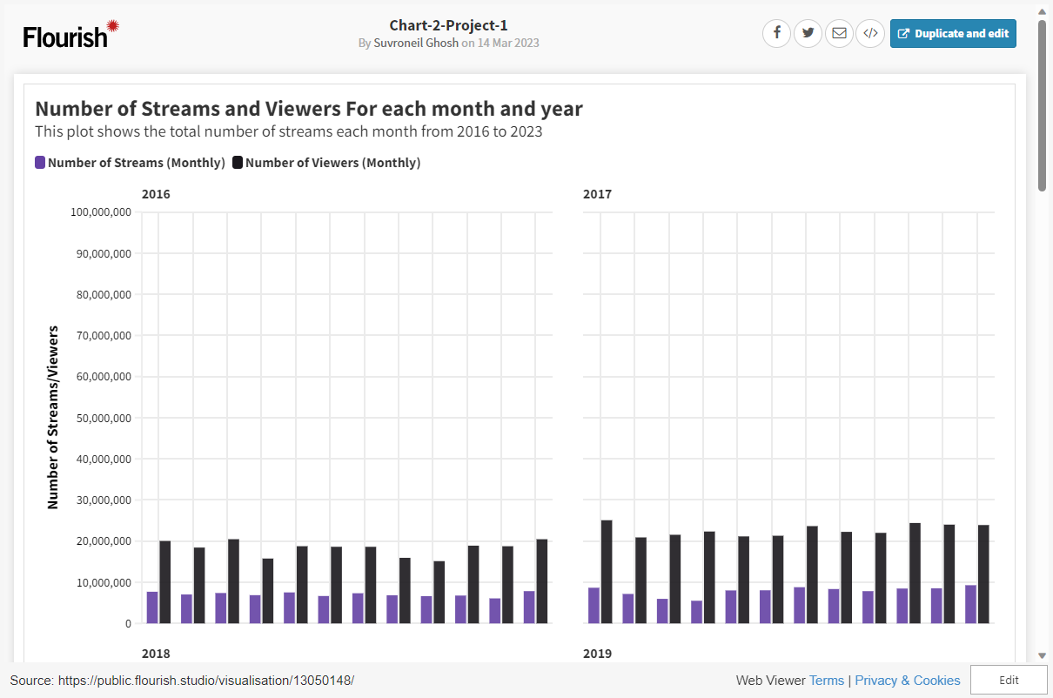
Comparing number of streams and viewers
The plot shows a steady increase in the total number of streams and viewers from 2016 to 2023, with a significant jump in 2020 possibly due to the COVID-19 lockdown restrictions.
1
This is the first
thing.
4
This is the fourth
thing.
2
This is the second
thing.
5
This is the fifth
thing.
3
This is the third
thing.
6
This is the sixth
thing.

Slide 12


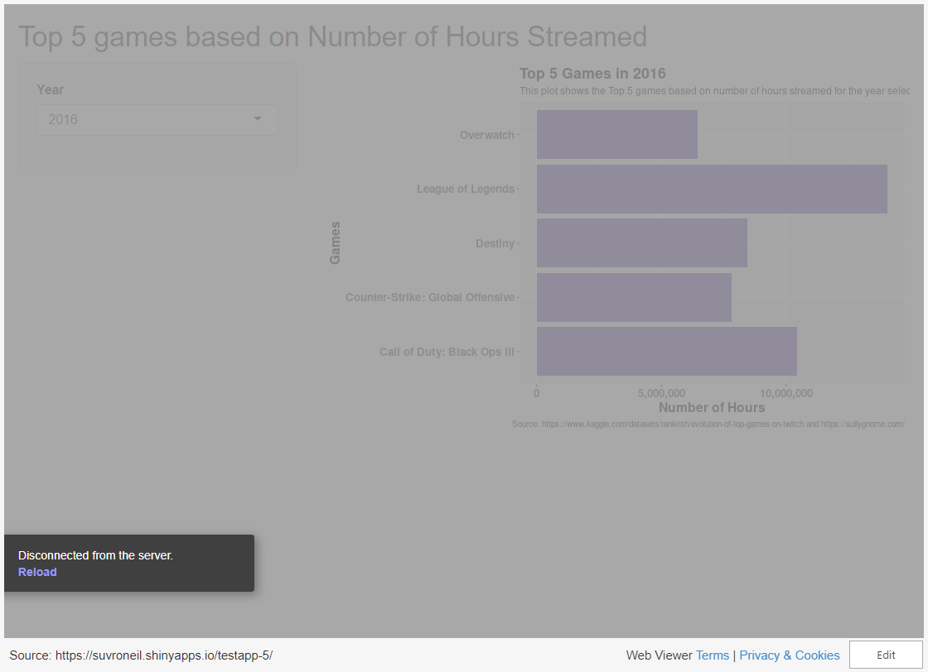
Top 5 games based on number of hours streamed
This plot shows the top 5 games streamed on Twitch each year from 2016 to 2023, with League of Legends consistently being in the top 5 until 2021, which might be due to streamers shifting to other popular games and new streamers opting for less competitive games.
1
This is the first
thing.
4
This is the fourth
thing.
2
This is the second
thing.
5
This is the fifth
thing.
3
This is the third
thing.
6
This is the sixth
thing.

Slide 13

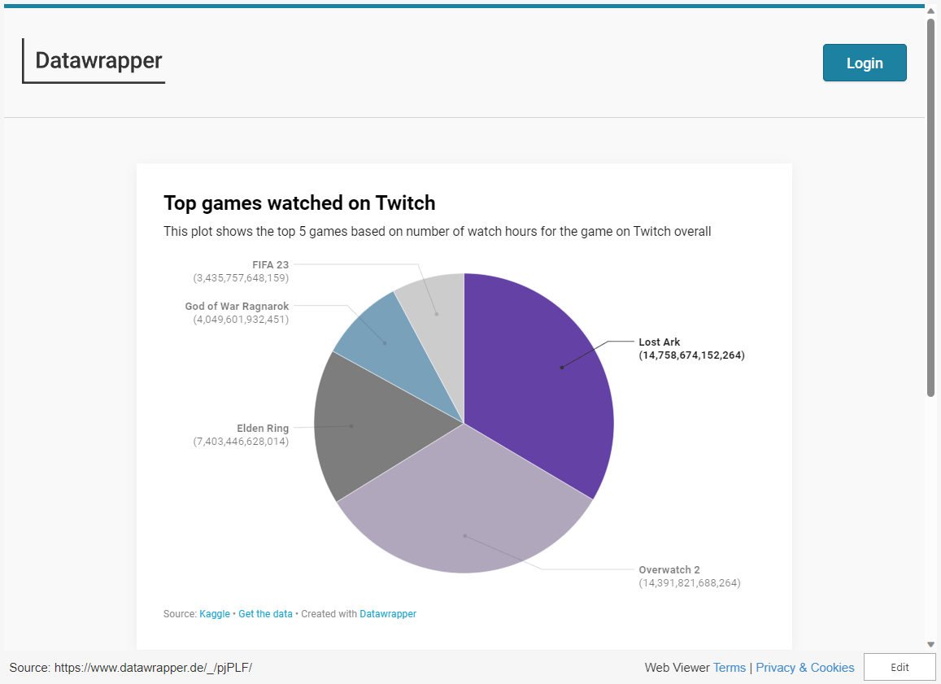
Top games watched on Twitch from 2016 - 2023
This plot compares the top 5 games by watch hours on Twitch and shows that Lost Ark has the highest number of watch hours while FIFA 23 has the lowest, and possible reasons for these trends were investigated through research.
1
This is the first
thing.
4
This is the fourth
thing.
2
This is the second
thing.
5
This is the fifth
thing.
3
This is the third
thing.
6
This is the sixth
thing.

Slide 14

Section 3
ESPORTS
16

Slide 15

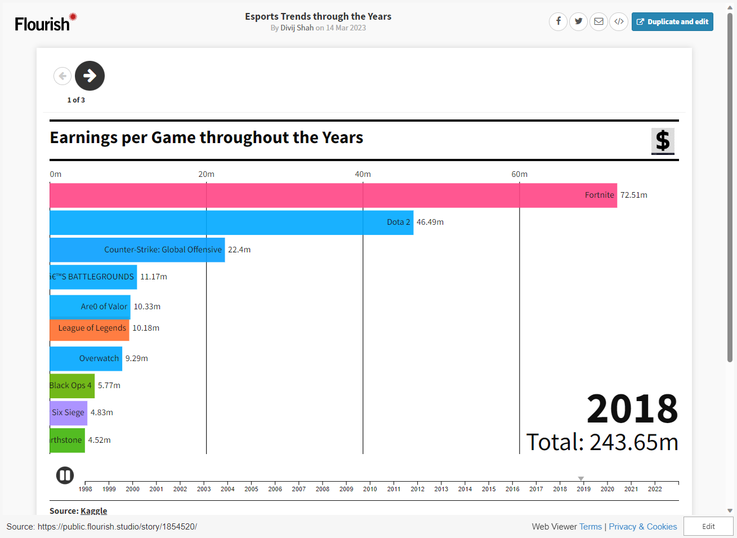
Esports through the Years
Overview of the esports industry's growth and trends from 1998 to 2023, including data on over 450,000 participants, 500 games, $1 billion in revenue, and 50,000 tournaments, highlighting key games with consistent earnings and high numbers of players and tournaments..
1
This is the first
thing.
4
This is the fourth
thing.
2
This is the second
thing.
5
This is the fifth
thing.
3
This is the third
thing.
6
This is the sixth
thing.

Slide 16

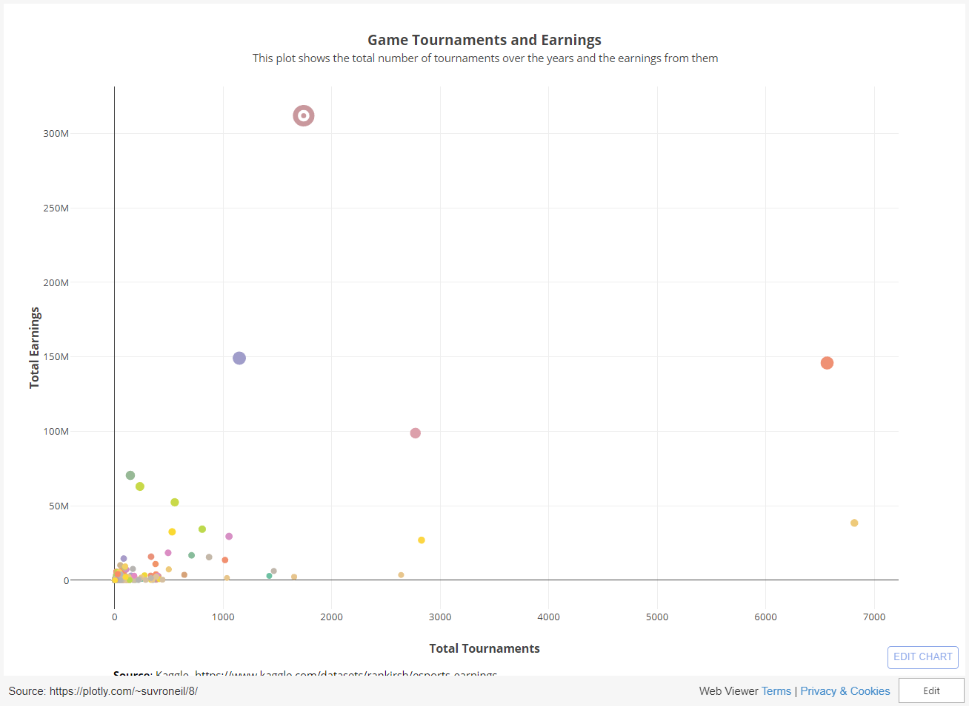
Total Earnings and Tournament Impact on Popular Games
The chart provides insights on the world of esports, highlighting significant differences in earnings between games with similar numbers of tournaments, with Dota 2 and Starcraft II as examples, suggesting that tournament scale and quality play a significant role in overall earnings.
1
This is the first
thing.
4
This is the fourth
thing.
2
This is the second
thing.
5
This is the fifth
thing.
3
This is the third
thing.
6
This is the sixth
thing.

Slide 17

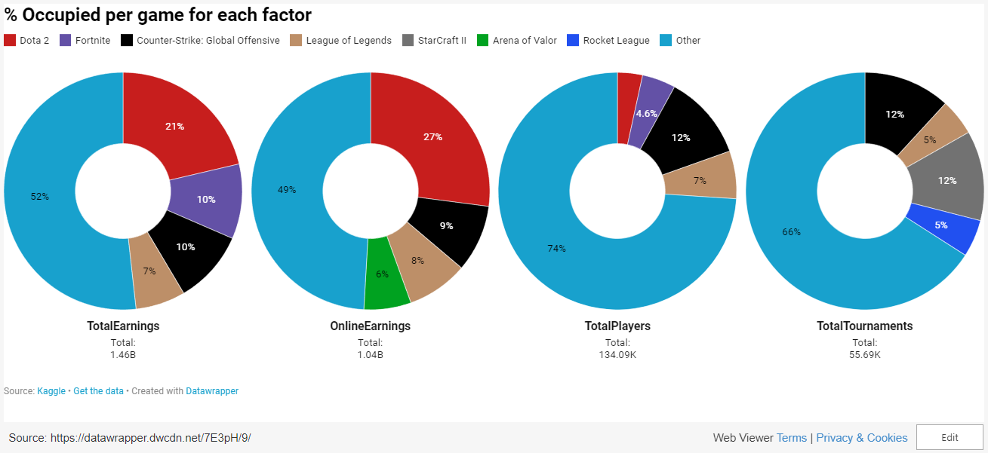
Key Insights and Implications for Industry Success
Insights into the esports industry's occupancy percentage across multiple factors, highlighting the importance of well-organized tournaments, dynamic market conditions, and unique factors contributing to the success of each game.
1
This is the first
thing.
4
This is the fourth
thing.
2
This is the second
thing.
5
This is the fifth
thing.
3
This is the third
thing.
6
This is the sixth
thing.

Slide 18

TRENDS FROM 2016-2020

Slide 19

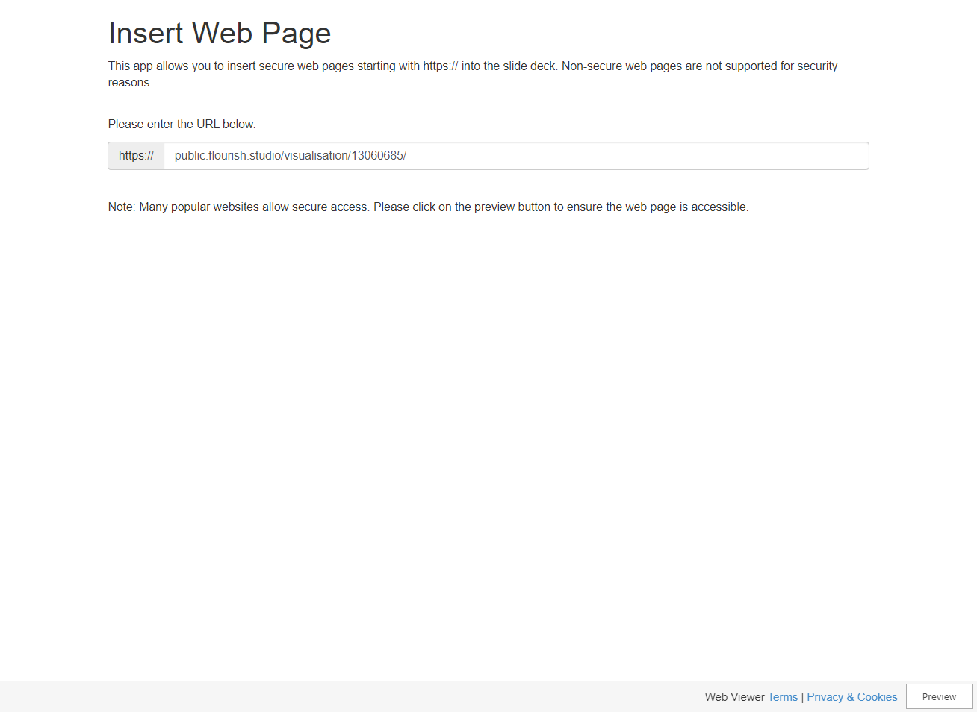
Top 5 games with highest quantity of shipments
Top five video games in terms of total units shipped during their respective release years, highlighting the importance of gameplay and storyline in the success of video games such as PLAYERUNKNOWN'S BATTLEGROUNDS, Call of Duty: Modern Warfare, Mario Kart 8 Deluxe, Call of Duty: WWII, and Red Dead Redemption 2.
1
This is the first
thing.
4
This is the fourth
thing.
2
This is the second
thing.
5
This is the fifth
thing.
3
This is the third
thing.
6
This is the sixth
thing.

Slide 20

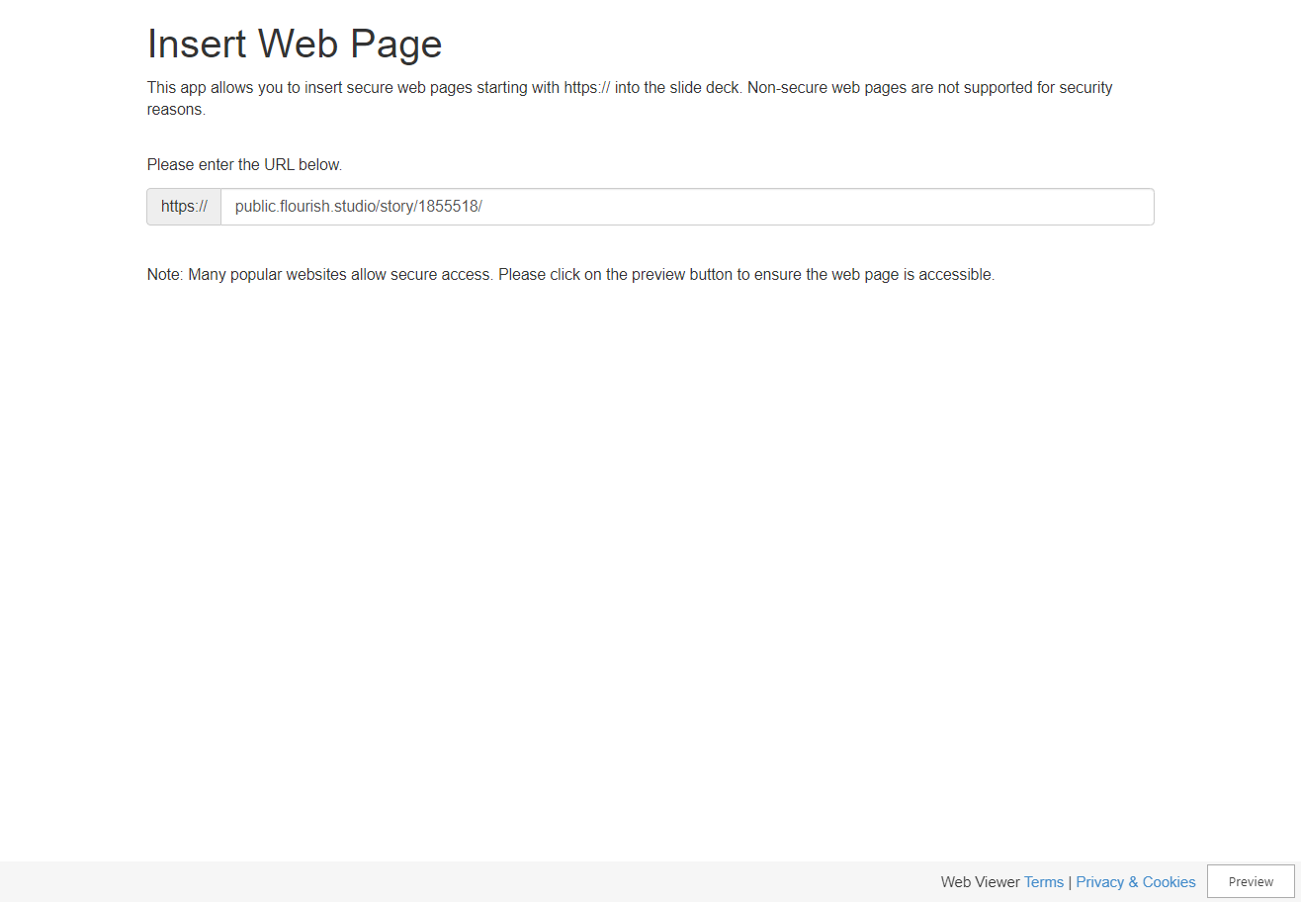
Analyzing viewer hours for top-selling games on multiple platforms
Trends in hours spent by viewers on the top 5 video games streamed on Twitch from 2016-2020, revealing that PLAYERUNKNOWN'S BATTLEGROUNDS had the most watch hours, reflecting its popularity among players and viewers, while Call of Duty: Modern Warfare, despite having high sales, had low watch hours due to being released in 2019 and requiring time to fix issues with the game.
1
This is the first
thing.
4
This is the fourth
thing.
2
This is the second
thing.
5
This is the fifth
thing.
3
This is the third
thing.
6
This is the sixth
thing.

Slide 21



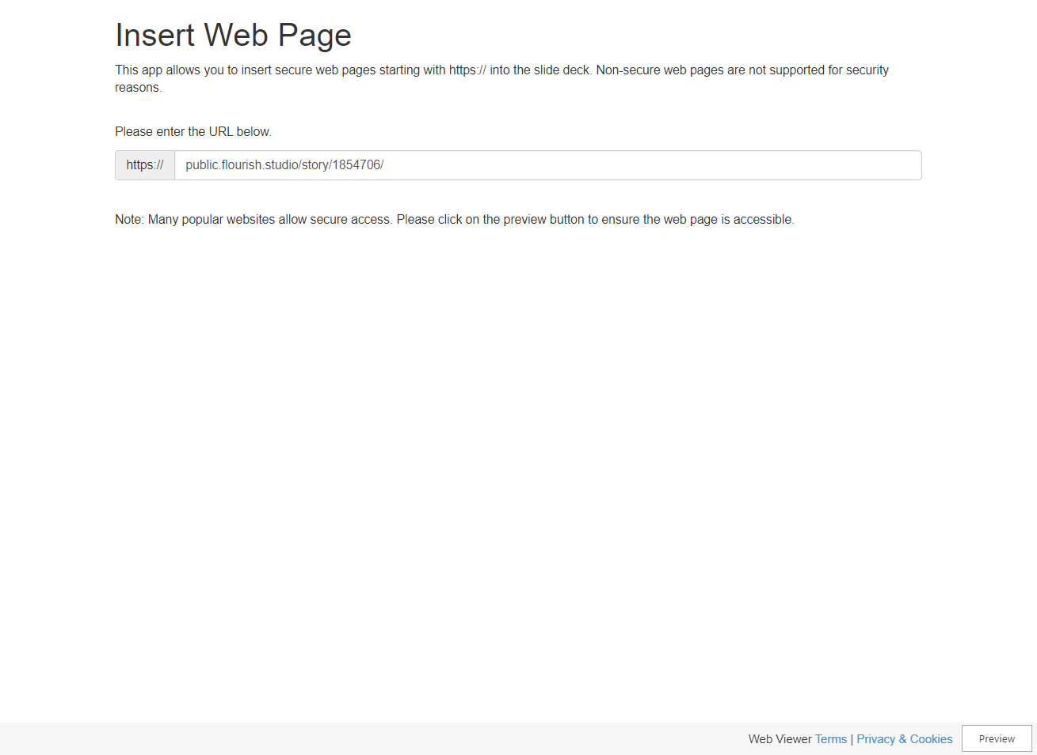
Analysis of Top Games in Esports
The chart displays the earnings, number of players, and tournaments for popular video games like Dota 2, Fortnite, Counter-Strike: Global Offensive, League of Legends, and Arena of Valor, revealing that esports is a booming industry with steady growth despite occasional fluctuations in earnings and popularity.
1
This is the first
thing.
4
This is the fourth
thing.
2
This is the second
thing.
5
This is the fifth
thing.
3
This is the third
thing.
6
This is the sixth
thing.

Slide 22





